Slide 1
Chatops Details
Maintain Bots LifeCycle Events like any other Apps!

Slide 2
Admin and configurable Json file Details
super admin for the access of Chatops Use the following command
$ python manage.py createsuperuser
Agent.Json is the configurable file available in the Dialog work flow enables the triggering point of the workflow

Slide 3
Salient Features of User Segment
User can access all the services they use right from the ChatOps.
Admins have a greater control on who can manipulate which resource and has an approval flow which enables management to control their spendings.
All the stakeholders are kept up to date with ongoing changes in the infrastructure.
Bot notifies about important events from the CI/CD pipelines.

Slide 4
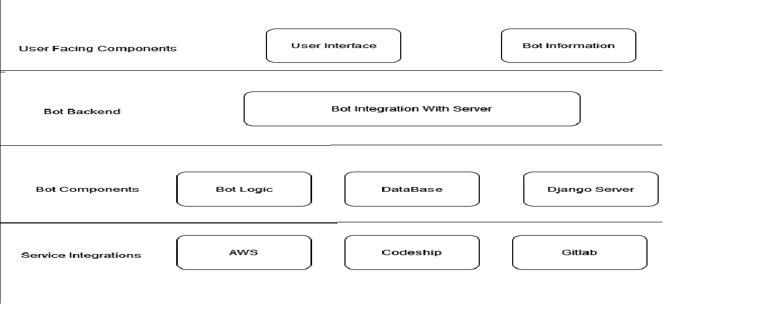
Flow Diagram

Slide 5
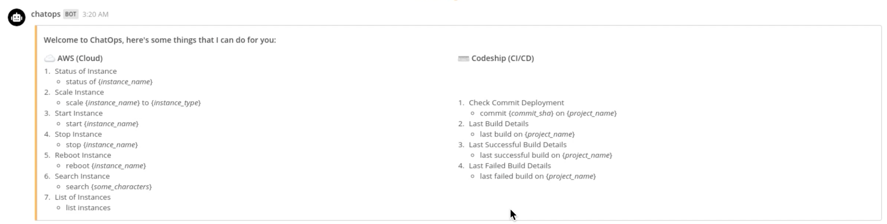
Instances

Slide 6
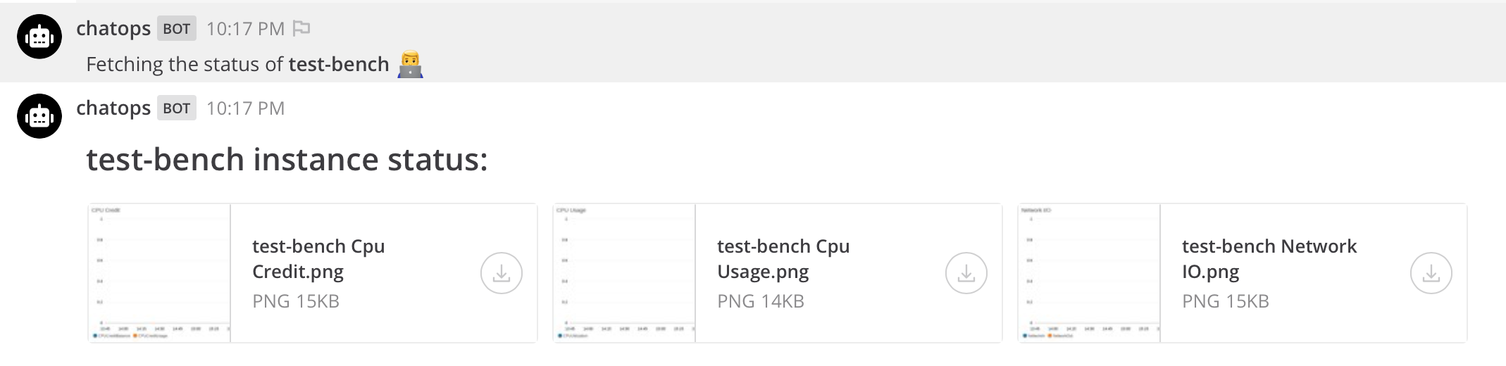
Verification of instance stats easily and quickly “Improves DevOps operations” “Effortless Access of statistics”

